Slide 1
QUARTERLY UPDATES TEAM CYGNUS
Q2 FY 18-19

Slide 2
Agenda
Team Highlights
Hall of Fame
Team Event
Team Appreciations
Team Versatility
Projects
Areas of Improvement
Best Routine Practices.
Future Road Map.

Slide 3






Team Highlighted
Abhishek
Amandeep
Moved to INV team.
Volunteered for TCL.
AKASH
team
Jioned our team for NO-Oracle project
Is involved in ACD and CPPF KT’s
Ajay
Helping us with CPPF tasks

Slide 4
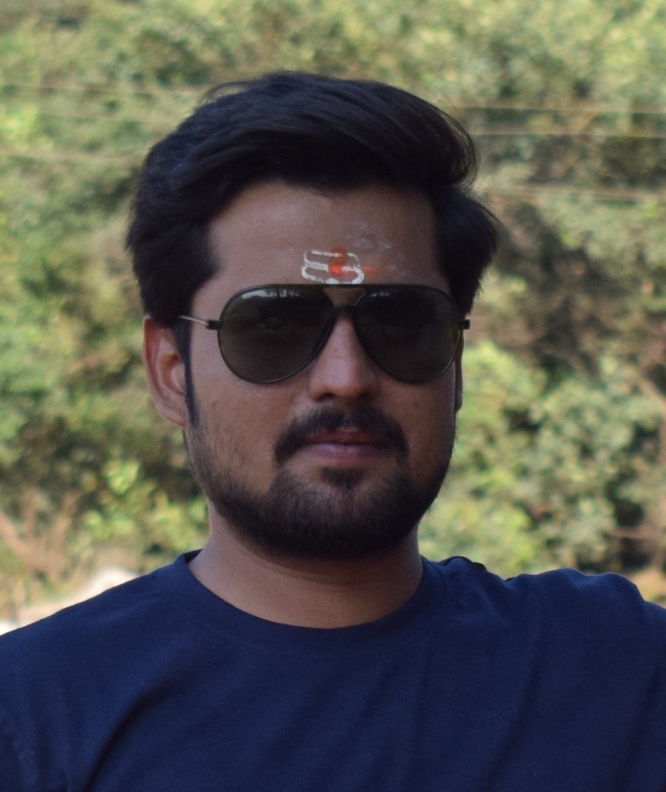
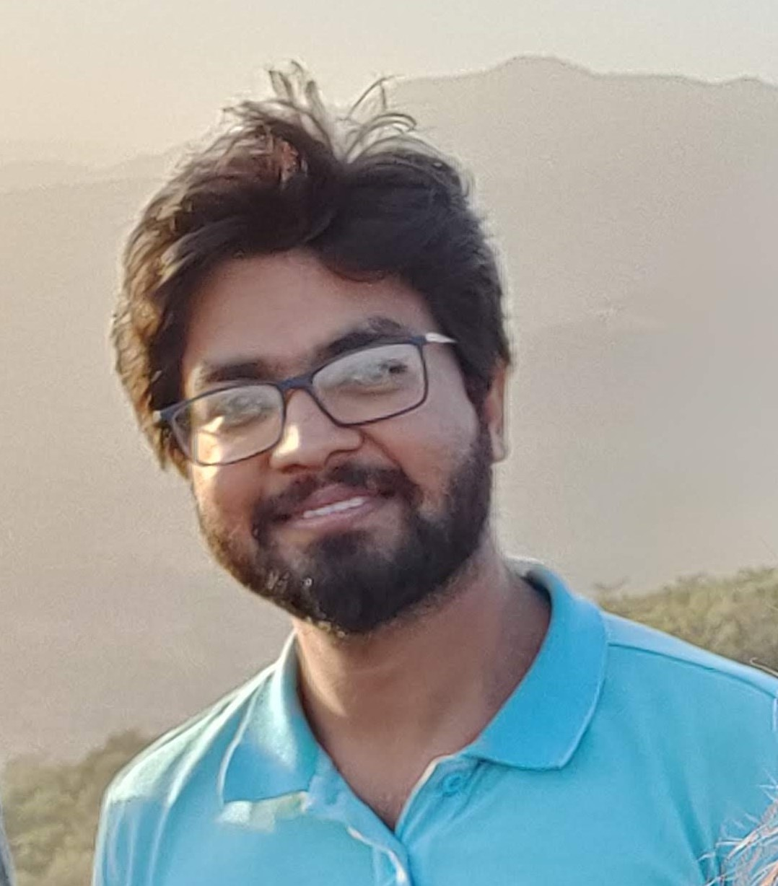
HALL OF FAME
MOHIT
AMANDEEP
COMPLETED UNIVATION MOOC
GOT RECOGNISED for cppf and amdd

Slide 5
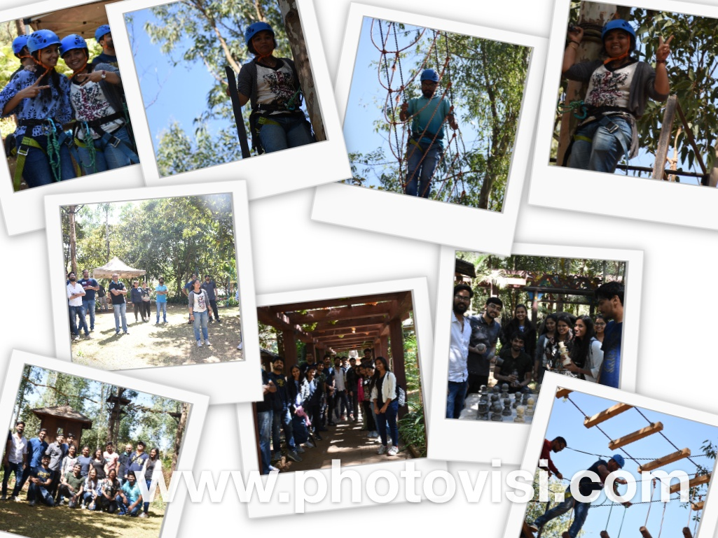
Team Event

Slide 6
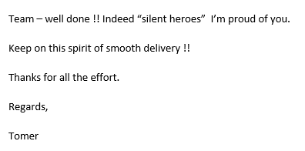
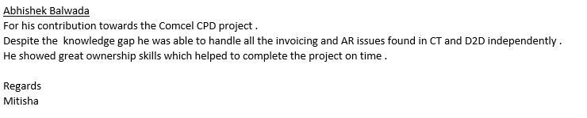
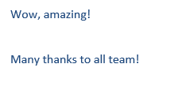
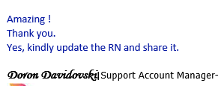
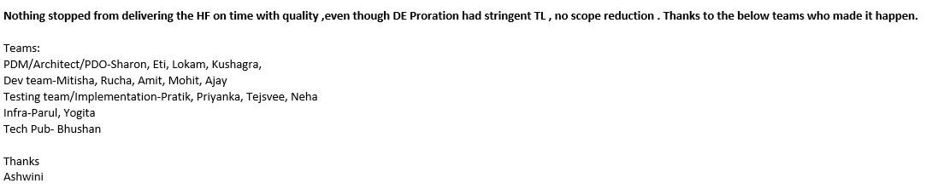
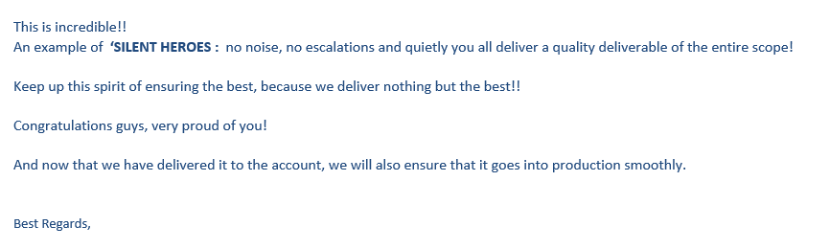
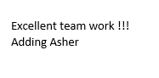
Team Appreciations

Slide 7
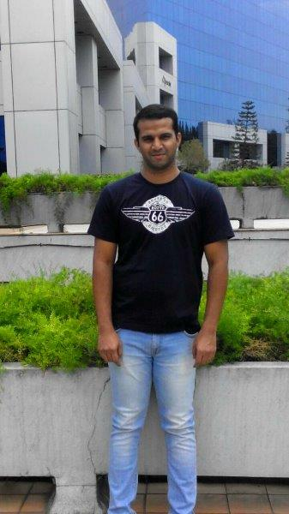
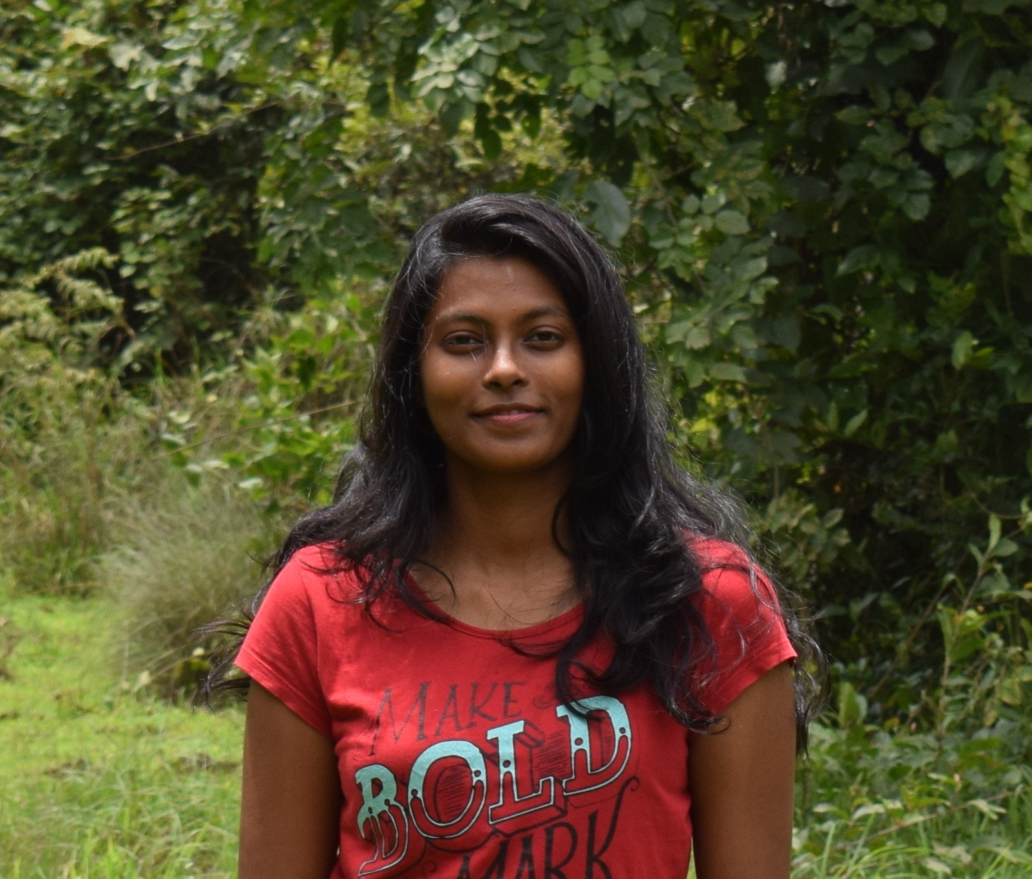
Team Versatility
Amandeep
Telkomsel issue handled
Currently working in NO Oracle Project
JAsind
Handled 2 upgrade CR’s for TMUS and BELL
Involved in CPPF issues
manasa
Handling most of the ACD issues.
Working also on CPPF external/internal issues
mohit
Handled TRB S1
Currently woking in NO Oracle project

Slide 8
Projects

Slide 9
AMDD
TARGET | ACHIEVEMENT | GOING FORWARD
TMUS AMDD upgrade | TMUS product upgrade(8.0 to 8.1.3 with PMX 10.0) was done and delivered to account with no major issue | Nothing pending – delivered to account as committed
BELL Upgrade
Streamline AMDD Delivery process | The target was to complete the HF release process for AMDD (Not met ☹) | Re-check the Jenkins build for AMDD again – nee infra assistance Need some ETA from Infra for the HF release process closure Escalation required
Front End Build for AMDD | Analyzed the effort for 8.1 . Need code changes due to dependency of Infragistics | Will be planned if capacity permits
Backlog in control | Backlog is in control | Start tracking SLAs for AMDD Cases/CRs

Slide 10
CPPF
TARGET | ACHEIVEMENTS | GOING FORWARD
CPPF Backlog | AC GR Enabled issue for ATT Mex. Handled few S1s within SLA Backlog in control in single digit Weekly target Met Productivity target met No SLA missed Couple of Utilities issues handled PMX upgrade Support | Plan to further reduce the aging CRs in CPPF Plan to implement some debugging solution for utilities.
One Team for CPPF and AMDD | Team members able to work on both CPPF and AMDD issues AC Configuration KT is Done. TRB flow assignment is in progress. | Increase the CPPF knowledge within the team

Slide 11
DEV ITEMS
TARGET | ACHEIVEMENTS | GOING FORWARD
DE CFD | Both drop delivered on time 100% automation done Account adoption in progress – no Major issues reported Delivered additional scope – BOD , step-tiered-conditional discounts | NFT is in progress (No Major issues as of now)
NO ORACLE | Estimates and plan for the PI9 is closed Dev on track Involves collaboration among various team in different location | D2D is planned and will be lead by our team
ASTRO CLOUD ENABLEMENT | For CPPF, changes done For AMDD, Planned to start from 8th May
COMCEL CPD CFD | Delivered on time No Major issue from account

Slide 12
Areas of Improvement
Documentation
Cases and CR’s
01
02
Started creating Documentation for any Issue, but need to ensure to be done 100%
Discussion within our team
UT
03
04
CPPF KT
Have to be more careful about review and UT
Continue with CPPF KT and assignments

Slide 13
Routine Best Practices
Daily Standups
Quite time is followed
Weekly plan discussed and shared within the team .
Weekly targets are met
Adhoc tasks tracked using jira

Slide 14
FUTURE ROADMAP
C++11 for C++ ARIC applications
2019
Q3
TMUS sync-sort removal for AMDD
Astro AWS for AMDD
Q3
Q2
Micro services training
Q4
2020

